Slide 1

Virtual/Physical Memory in SW/HW Communication (Week 9)
May 12, 2020
Sungjoo Yoo
Computing Memory Architecture Lab.
CSE, SNU
http://cmalab.snu.ac.kr

Slide 2
Weekly Schedule
W1 17 Application (deep learning on FPGA)/SW app (MNIST/CIFAR)
W2 25 Verilog 1 Basics/Vivado tutorial (verification level of HW design)
W3 31 Verilog 2 Combinational circuits (Video pre-view homework + TA Q&A)/Simple adder using dsp (V+V, Verilog intro)
W4 4/7 Verilog 3 Sequential circuits/V*V processing element (PE) design 1
W5 14 Verilog 4 Design example & synthesizable code/V*V processing element (PE) design 2
W6 21 Convolution lowering and matrix multiplication accelerator/Convolution lowering (V0)
W7 28 Intro to Zynq & MV accelerator design/Zynq FPGA & synthesis, continue VV design & start MV accelerator design
W8 5/5 (Children’s day) Optional lab session is provided in lecture and lab hour
W9 12 Main memory (physical & virtual)/OS+FPGA (HOST~DEVICE) communication & MV design 2
W10 19 Bus and DMA (Video pre-view + TA Q&A)/custom IP & MV design 3
W11 26 Advanced deep learning #1 quantization for low precision computation/V0+DMA+8b
W12 6/2 Advanced deep learning #2 zero skipping/V0+DMA+8b+zero-skipping 1
W13 9 Lecture summary/V0+DMA+8b+zero-skipping 2
W14 16 Final exam/Term project (V0+DMA+8b+zero) submission
Notes:
From this we will start to work on the baseline MV accelerator.

Slide 3
Agenda
Lecture
How can software access hardware accelerator?
How can hardware accelerator access main memory?
Introduction to the lab on Week 9

Slide 4


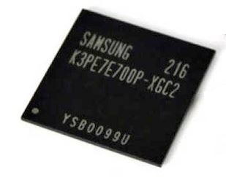
Lab in Week 9: How Can Software Access Hardware Accelerator?
PS-DRAM
Component
Xilinx Zynq (XC7Z020)
Processing System
(PS, ARM Co-A9)
Programmable Logic
(PL, Xilinx Artix-7)
Core #1
Matrix-Vector Multiplication Custom IP
Core #2
Memory interface
AXI master
BRAM

Slide 5
Contents
How can software access a hardware component?
Memory-mapped I/O
What happens when executing a load instruction?
Virtual to physical memory mapping
Translation lookaside buffer
Multi-level page table
How can hardware components access the main memory?
IOMMU
Hardware components use virtual address as well
VA (virtual address) to PA (physical address) mapping is done by IOMMU
Overview of Labs in Weeks 9 and 10

Slide 6
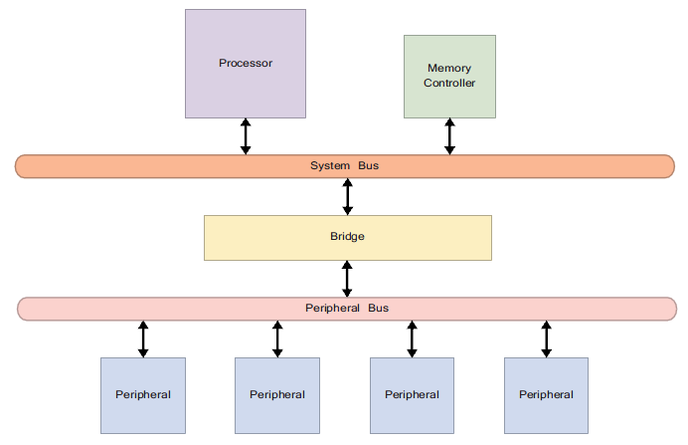
A Simplified View of Embedded System Hardware
[The Zynq Book, 2014]
Processor
Memory Controller
Peripherals
System Bus
Peripheral Bus
Notes:
Processor — This is the ‘brains' of the system. It is programmed to perform the tasks specific to the application of the embedded system
Memory Controller — Memory controllers manage the reading and writing of data to and from main memory in an embedded system. Memory controllers reside in on-chip soft cores, providing an interface between the system memory and all other parts of the system
Peripherals — These are the components around the central processing unit. Peripherals can be implemented as individual integrated circuits, be contained on-chip with the processor, or may reside in an area of programmable logic such as an FPGA.
System Bus — In an embedded system with multiple buses, the system bus connects the processor, memory controller and other high-speed devices together. As such, it is the bus with the greatest bandwidth in the system
Peripheral Bus — The second bus creates two separate sections of the system, allowing two arbiters to control and manage communications across the two buses. This allows devices on the peripheral bus to communicate with each other, even when a high-priority processor-memory transaction is taking place on the system bus

Slide 7
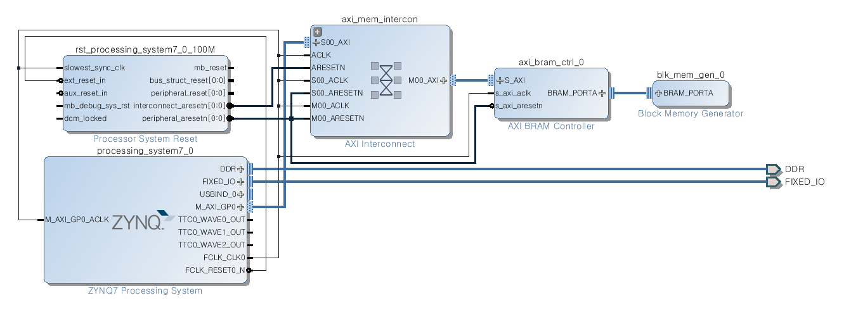
CPU and Memory (BRAM) on PL
Connecting CPU and BRAM (Block Random Access Memory)
CPU in PS & AXI interconnect + BRAM controller + BRAM in PL
Our question
How does our software access BRAM?
Xilinx Zynq (XC7Z020)
Processing System
(PS, ARM Co-A9)
Programmable Logic
(PL, Xilinx Artix-7)
BRAM
Core #1
Matrix-Vector Multiplication Custom IP
Core #2
Memory interface
AXI master
BRAM
PS

Slide 8
Questions on Communication in Hardware System
How does my software communicate with a hardware component?
Case 1: Consider the hardware component as a part of memory
a.k.a. memory-mapped I/O, i.e., load/store instructions from/to a physical address in memory
Case 2: Consider it as a device
Device driver is used

Slide 9
A Quick Answer: Physical Memory of BRAM and mmap()
BRAM is located @ address 0x4000_0000 ~ 0x4000_1FFF
Note) DRAM (BD.IC25/26) is @ address 0x0000_0000 ~ 0x3FFF_FFFF

Slide 10
Hardware Components are Assigned Their Own Physical Addresses
[The Zynq Book, 2014]
BRAM is assigned a physical address region
Who does this assignment?
System designer
0x4000_0000~0x4000_ffff
BRAM

Slide 11
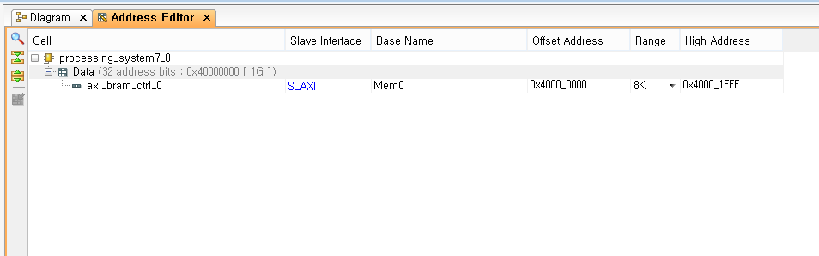
Setting Physical Memory Address Region of BRAM using mmap() and Xilinx tool
BRAM is located @ address 0x4000_0000 ~ 0x4000_1FFF
Note) DRAM (BD.IC25/26) is @ address 0x0000_0000 ~ 0x3FFF_FFFF
System call mmap() can be used to access BRAM
int foo = open(“/dev/mem”, O_RDWR);
int *ptr = mmap(NULL, size, PROT_READ|PROT_WRITE, MAP_SHARED, foo, 0x40000000);
BRAM ADDR

Slide 12
Software Code Using mmap() to Access BRAM
int foo = open("/dev/mem", O_RDWR);
// Given a pathname for a file, open() returns a file descriptor
// ‘dev/mem’ refers to the system’s physical memory
// O_RDWR means both readable and writable access mode
int *fpga_bram = mmap(NULL, SIZE * sizeof(int), PROT_READ|PROT_WRITE, MAP_SHARED, foo, 0x40000000);
// mmap() creates a new mapping in the virtual address space of the calling process
// NULL means that the kernel chooses the address for mapping
// SIZE specifies the length of the mapping
// PROT_ arguments describe the memory protection (RD/WR)
// MAP_SHARED makes updates visible to other processes
// foo indicates the file descriptor to be mapped
// 0x4000_0000 refers to offset of the file descriptor → physical address for BRAM
for (i = 0; i < SIZE; i++)
*(fpga_bram + i) = (i * 2);
// write arbitrary data on the BRAM area
printf("%-10s%-10s\n", "addr", "FPGA(hex)");
for (i = 0; i < SIZE; i++)
printf("%-10d%-10X\n", i, *(fpga_bram + i));
// read and show the data to check if BRAM’s working correctly

Slide 13
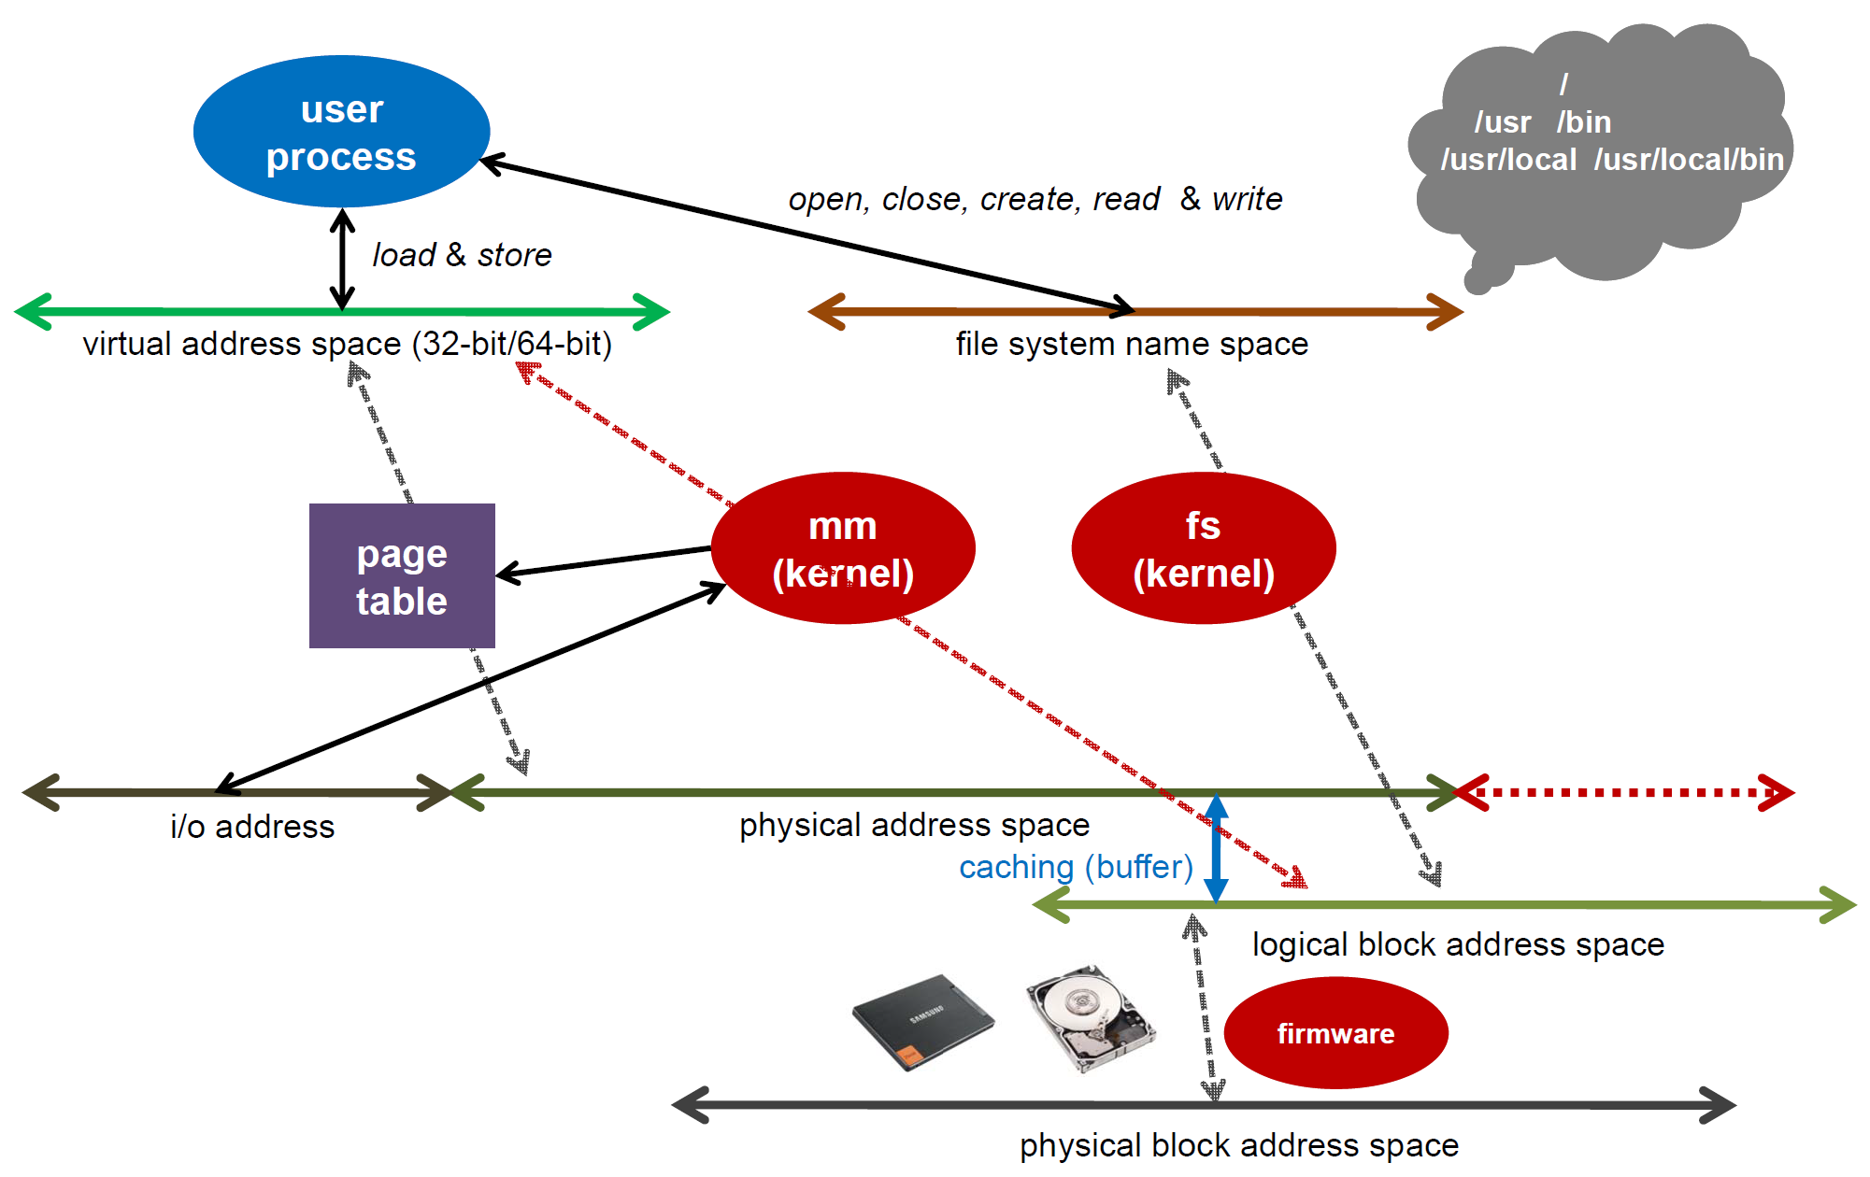
Memory/Storage Address Space
[Cho, 2015]
???
fpga_bram
0x4000_000

Slide 14
Memory/Storage Address Space
[Cho, 2015]
???
fpga_bram
0x4000_000

Slide 15
Page Table to Keep Virtual to Physical Address Mapping Information
My program
Page start addresses
12030000h
Page table
Main memory
0A084000h
12030000h→00043000h
0F275000h
0A084000h→0F275000h
00200000h→0EFA0000h
0EFA0000h
00043000h
00200000h

Slide 16
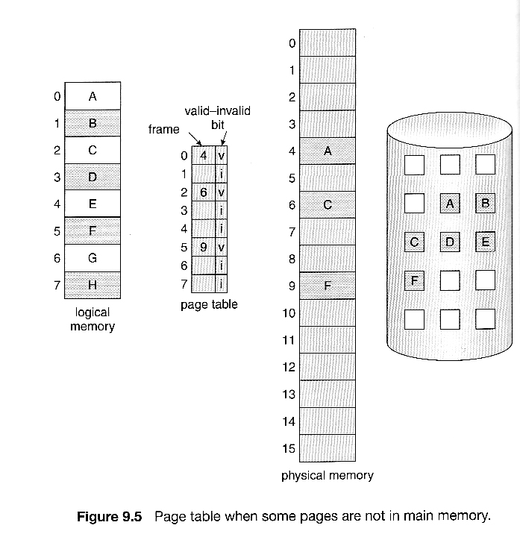
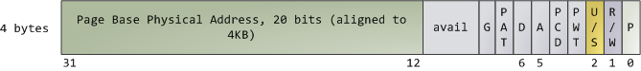
Page Table
[Abraham Silberschatz, Greg Gagne, and Peter Baer Galvin, "Operating System Concepts, Ninth Edition ", Chapter 9]
Hierarchical page table
In reality, the page table is constructed in a hierarchical manner
A virtual page is the unit of memory protection because all of its bytes share the U/S and R/W flags
PTE (page table entry)
P: presence, R/W: read only or not
U/S: user/supervisor
A: accessed, D: dirty
G: granularity (4KB or 4MB)

Slide 17
Software Code Using mmap() to Access BRAM
int foo = open("/dev/mem", O_RDWR);
// Given a pathname for a file, open() returns a file descriptor
// ‘dev/mem’ refers to the system’s physical memory
// O_RDWR means both readable and writable access mode
int *fpga_bram = mmap(NULL, SIZE * sizeof(int), PROT_READ|PROT_WRITE, MAP_SHARED, foo, 0x40000000);
// mmap() creates a new mapping in the virtual address space of the calling process
// NULL means that the kernel chooses the address for mapping
// SIZE specifies the length of the mapping
// PROT_ arguments describe the memory protection (RD/WR)
// MAP_SHARED makes updates visible to other processes
// foo indicates the file descriptor to be mapped
// 0x4000_0000 refers to offset of the file descriptor → physical address for BRAM
fpga_bram
0x4000_0000

Slide 18
What is the Contents in PTE (Page Table Entry)?
int foo = open("/dev/mem", O_RDWR);
// Given a pathname for a file, open() returns a file descriptor
// ‘dev/mem’ refers to the system’s physical memory
// O_RDWR means both readable and writable access mode
int *fpga_bram = mmap(NULL, SIZE * sizeof(int), PROT_READ|PROT_WRITE, MAP_SHARED, foo, 0x40000000);
// mmap() creates a new mapping in the virtual address space of the calling process
// NULL means that the kernel chooses the address for mapping
// SIZE specifies the length of the mapping
// PROT_ arguments describe the memory protection (RD/WR)
// MAP_SHARED makes updates visible to other processes
// foo indicates the file descriptor to be mapped
// 0x4000_0000 refers to offset of the file descriptor → physical address for BRAM
fpga_bram
0x4000_0000
0x4000_0000
b0100_0000_0000_0000_0000_0000_0000_0000
→b0001_0000_0000_0000_0000_0000→0x10_0000

Slide 19
Private Virtual Address Space per Process
[Source: K. Asanovic, 2008]
Process 1
OS
pages
VA1
Physical
Memory
Page Table
Process 2
VA1
Page Table
Process 3
VA1
Page Table
free
Each process has its own page table

Slide 20
Page Tables in Physical Memory
[Source: K. Asanovic, 2008]
PT User 1
VA1
PT User 2
User 1
VA1
User 2
Page table, requiring 4MB per process, is too big to be stored on CPU chip and thus stored in main memory
The size of CPU cache is typically 1~10MB

Slide 21
Caching Page Table Accesses in TLB
[Source: K. Asanovic, 2008]
e.g., 50 cycles
PT User 1
$
VA1
0 cycle!
PT User 2
User 1
0 cycle!
VA1
e.g., 50 cycles
User 2

Slide 22
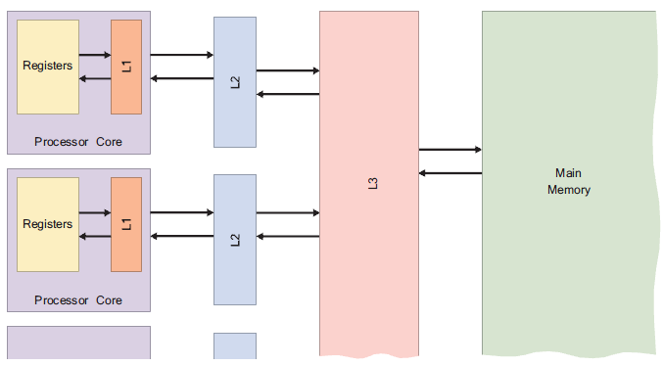
Main Memory and Cache
[The Zynq Book, 2014]
Main memory
Dynamic RAM (DRAM)
Cache
Static RAM (SRAM)
L1 cache
1~2 clock cycles, ~32KB
Instruction (I) cache, data (D) cache
L2 cache
~10 clock cycles, 100KB~1MB
Shared I+D
L3 cache
~50 clock cycles, 1MB~10MB
eDRAM for better area efficiency in IBM PowerPC
TLB (translation lookaside buffer)
For virtual address to physical address translation
Notes:
A cache is a small memory located between the CPU and main memory. It has a lower access time than main memory and the cache is not accessible via the system bus. Cache is used to store data that is frequently accessed by the processor from main memory. Operations which make use of cached data are therefore much faster than those where the data is in main memory only
As processors typically read data at a much faster rate than the system’s main memory, the processor speed is constrained to that of the memory. By including cache memory in a system — which contains the most frequently accessed data that can be read at a higher rate than main memory — the processor is no longer constrained to the speed of the main memory. This leads to an increased efficiency in terms of data access. The processor speed is still limited, however, in the event of a cache miss — whereby the processor fails in its attempt to read or write data in the cache. This results in the data being read/written to main memory, and increased access latency
DRAM
DRAM is the most common form of memory that is used in computing systems. A DRAM chip consists of a number of memory cells which can each hold 1-bit of data, stored in a capacitor. Every memory cell also features a transistor, which acts as a switch to allow the control circuitry to read or write the state of the capacitor. As both the capacitor and transistor are extremely small, millions of individual memory cells can fit in a single DRAM chip.
Due to the fact that capacitors leak electric charge, the state of the bit of information held by each memory cell will eventually fade unless the charge of the capacitor is periodically refreshed by the memory controller. The memory controller does this by reading the state of each memory cell and then writing the state back again. This is where dynamic RAM gets its name
SRAM
SRAM uses a different technology to store information than DRAM. Whereas each bit of memory in DRAM is stored in a capacitor, SRAM uses latches to store the data. Each memory cell requires 4 or 6 latches to store a single bit of data, and therefore requires much more space on a chip than DRAM, making it more expensive.The upside to SRAM is that it does not need to be refreshed, thus making it much faster than DRAM. Due to the expense of SRAM, it is usually only used in high-speed, low-capacity memory chips
L1 cache
L1 cache is the smallest form of cache memory, the size of which is typically 8 to 128 KB. It is implemented in the form of SRAM which is built into the fabric of the processor core and, as such, operates at the same clock rate. L1 cache typically consists of two sections: data and instruction caches.
L1 cache is used to store a local copy of frequently accessed data and instructions, enabling instant access by the processor
L2 cache
L2 cache is usually external to individual processing cores, but is located extremely close by. It is larger than L1 cache, typically in the region of 256 to 1024 KB, but has slower access speeds. L2 cache is in the form of DRAM and is unified in a single section (unlike L1 which is split into two sections). Larger quantities of data are constantly read in by L2 cache from main memory before being fed to L1
L3 Cache
Level 3 (L3) cache is shared among all processor cores. It is also implemented in DRAM, and is the largest form of cache memory, typically in sizes of 2 MB and upwards

Slide 23
Translation Lookaside Buffers (TLB)
[Source: K. Asanovic, 2008]
Address translation is very expensive!
In a two-level page table, each reference becomes several memory accesses
Solution: Cache translations in TLB
TLB hit ⇒ Single Cycle Translation
TLB miss ⇒ Page Table Walk to refill
virtual address
VPN offset
V R W D tag PPN
(VPN = virtual page number)
(PPN = physical page number)
hit?
physical address
PPN offset

Slide 24
Address Translation & Protection
[Source: K. Asanovic, 2008]
Virtual Address
Virtual Page No. (VPN)
offset
Kernel/User Mode?
Read-only or Writable?
Protection
Check
Address
Translation
Exception?
Physical Address
Physical Page No. (PPN)
offset
Every instruction and data access (to cache) needs address translation and protection checks

Slide 25
Flat Page Tables are Expensive
[Source: K. Asanovic, 2008]
PT User 1
VA1
PT User 2
User 1
VA1
User 2
If you run 100 processes each requiring its own page table of 4MB, the total page table size, 400MB is too big

Slide 26
Hierarchical Page Table to Reduce Page Table Size
[Source: K. Asanovic, 2008]
Virtual Address
31
22
21
12
11
0
p1 p2 offset
10-bit
L1 index
10-bit
L2 index
offset
p2
Root of the Current
Page Table
p1
(Processor register, e.g., CR3 in x86)
Level 1
Page Table
Level 2
Page Tables
page in primary memory
page in secondary memory
PTE of a nonexistent page
Data Pages

Slide 27
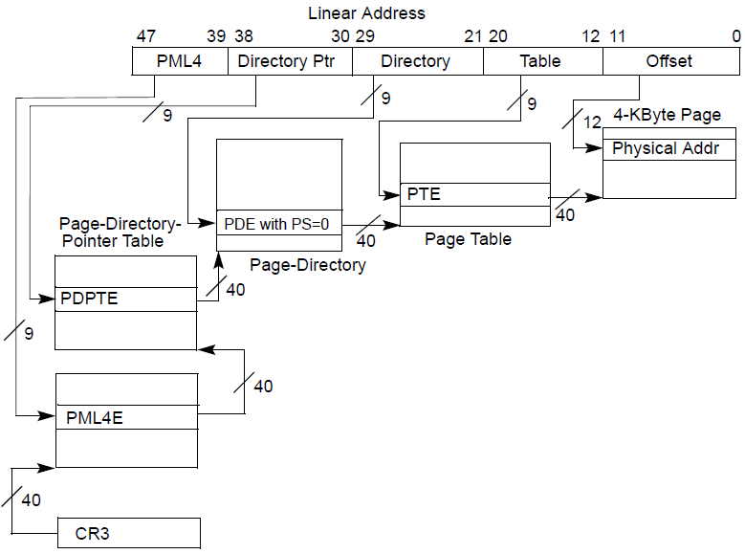
Page Table with 48b Address
[Intel® 64 and IA-32 Architectures Software Developer’s Manual]
All the tables are stored in main memory
How many memory accesses for address translation?

Slide 28
TLB Miss Penalty in Hierarchical Page Table
[Intel® 64 and IA-32 Architectures Software Developer’s Manual]
Since all the tables are stored in main memory, in the worst case, 4 memory accesses for address translation occur, ~50ns x 4=200ns!
Then, the PTE is stored
in translation lookaside buffer (TLB)

Slide 29
Paging with 48b Address TLB and MMU Cache
[Intel® 64 and IA-32 Architectures Software Developer’s Manual]
TLB and MMU cache stores recently accessed entries to reduce the average latency of address translation
Caching recently accessed PTEs
near the CPU
in translation lookaside buffer (TLB)
Caching recently accessed entries of page directories
in MMU cache

Slide 30
Main Memory and Cache
[The Zynq Book, 2014]
Main memory
Dynamic RAM (DRAM)
Cache
Static RAM (SRAM)
L1 cache
1~2 clock cycles, ~32KB
Instruction (I) cache, data (D) cache
L2 cache
~10 clock cycles, 100KB~1MB
Shared I+D
L3 cache
~50 clock cycles, 1MB~10MB
eDRAM for better area efficiency in IBM PowerPC
TLB (translation lookaside buffer)
For virtual address to physical address translation

Slide 31
Software Code Using mmap() to Access BRAM
int foo = open("/dev/mem", O_RDWR);
// Given a pathname for a file, open() returns a file descriptor
// ‘dev/mem’ refers to the system’s physical memory
// O_RDWR means both readable and writable access mode
int *fpga_bram = mmap(NULL, SIZE * sizeof(int), PROT_READ|PROT_WRITE, MAP_SHARED, foo, 0x40000000);
// mmap() creates a new mapping in the virtual address space of the calling process
// NULL means that the kernel chooses the address for mapping
// SIZE specifies the length of the mapping
// PROT_ arguments describe the memory protection (RD/WR)
// MAP_SHARED makes updates visible to other processes
// foo indicates the file descriptor to be mapped
// 0x4000_0000 refers to offset of the file descriptor → physical address for BRAM
for (i = 0; i < SIZE; i++)
*(fpga_bram + i) = (i * 2);
// write arbitrary data on the BRAM area
printf("%-10s%-10s\n", "addr", "FPGA(hex)");
for (i = 0; i < SIZE; i++)
printf("%-10d%-10X\n", i, *(fpga_bram + i));
// read and show the data to check if BRAM’s working correctly

Slide 32
Decomposing Load Instruction Execution: Reading from A Hardware Component, e.g., BRAM
Step 1: Load unit accesses L1 data cache
TLB access for virtual address to physical address translation
Non-cacheable access for hardware components other than main memory

Slide 33
A Tip of Iceberg?
[The Zynq Book, 2014]
CPU to L1 cache
VA to PA by TLB
What happens next?
0x4000_000~0x4000_ffff
BRAM

Slide 34
Reading from A Hardware Component, e.g., BRAM Will Be Covered in Week10 Lecture
Step 1: Load unit accesses L1 data cache
TLB access
Non-cacheable access
Step 2: CPU sends a read request to the bus
What does “read request” exactly mean?
Step 3: Bus determines the destination and forwards the read request to the destination
How can the bus determine the destination?
What does ‘forward’ exactly mean?
Step 4: The hardware component receives the read request and sends the required data to the bus
What does “receive the read request” exactly mean?
Step 5: Bus forwards the data to CPU
Step 6: CPU stores the data in its registers

Slide 35
Contents
How can software access a hardware component?
Memory-mapped I/O
What happens when executing a load instruction?
Virtual to physical memory mapping
Translation lookaside buffer
Multi-level page table
How can hardware components access the main memory?
IOMMU
Hardware components use virtual address as well
VA (virtual address) to PA (physical address) mapping is done by IOMMU
Overview of Labs in Weeks 9 and 10

Slide 36
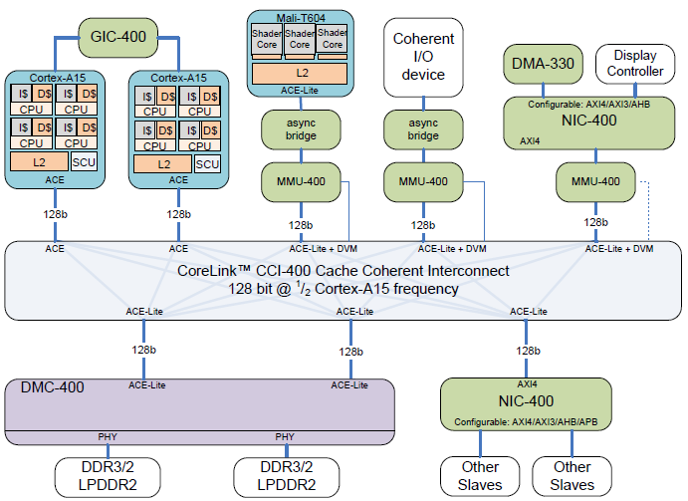
Hardware Devices Require Virtual Address
[Stevens, 2011]

Slide 37
What Happens if Hardware Components Use Physical Address?
Each hardware component is assigned a fixed region of physical address
mp3
Disp
Modem
Codec
3D
graphics
User applications
Fixed

Slide 38
What Happens if Hardware Components Use Physical Address?
Each hardware component is assigned a fixed region of physical address
What if you use only text messaging for now?
Waste of main memory resource due to fixed physical address allocation
mp3
Disp
Modem
Codec
3D
graphics
User applications
Fixed
mp3
Disp
Modem
Codec
3D
graphics
User applications

Slide 39
IOMMU for Better Utilization of Memory
Each device is assigned a fixed region of physical address
What if you use only text messaging for now?
Waste of main memory resource due to fixed physical address allocation
Solution? IOMMU!
Hardware components use virtual address
IOMMU does VA to PA translation for hardware components
mp3
Disp
Modem
Codec
3D
graphics
User applications

Slide 40
Private Virtual Address Space per HW Comp.
[Source: K. Asanovic, 2008]
HW 1
OS
pages
VA1
Physical
Memory
Page Table
HW 2
VA1
Page Table
HW 3
VA1
Page Table
free
Each HW component has its own page table

Slide 41
IOMMU for Better Utilization of Memory
Each device is assigned a fixed region of physical address
What if you use only text messaging for now?
Waste of main memory resource due to fixed physical address allocation
IOMMU enables better utilization of memory resource
mp3
Disp
Modem
Codec
3D
graphics
User applications
App1
Disp
Modem
App2
App3
Modem
App4

Slide 42
IOMMU (Input Output Memory Management Unit)
Each device needs its own TLB for VA to PA translation before accessing main memory

Slide 43
Contents
How can software access a hardware component
Memory-mapped I/O
VA to PA mapping
How can hardware components access the main memory?
IOMMU
Overview of Labs in Weeks 9 and 10
Xilinx Zynq (XC7Z020)
Processing System
(PS, ARM Co-A9)
Programmable Logic
(PL, Xilinx Artix-7)
Core #1
Matrix-Vector Multiplication Custom IP
Core #2
Memory interface
AXI master
BRAM

Slide 44
Week 9: SW Communicates with BRAM

Slide 45
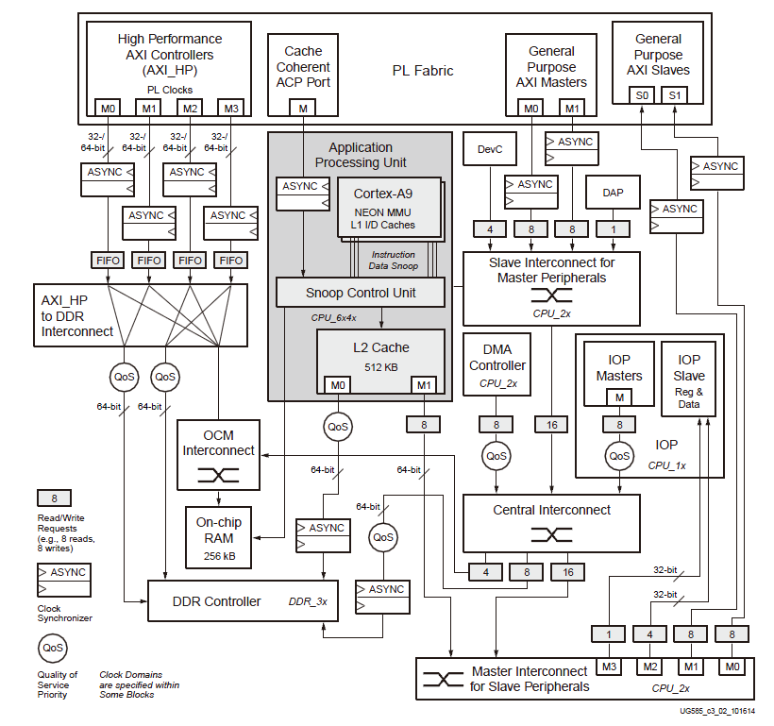
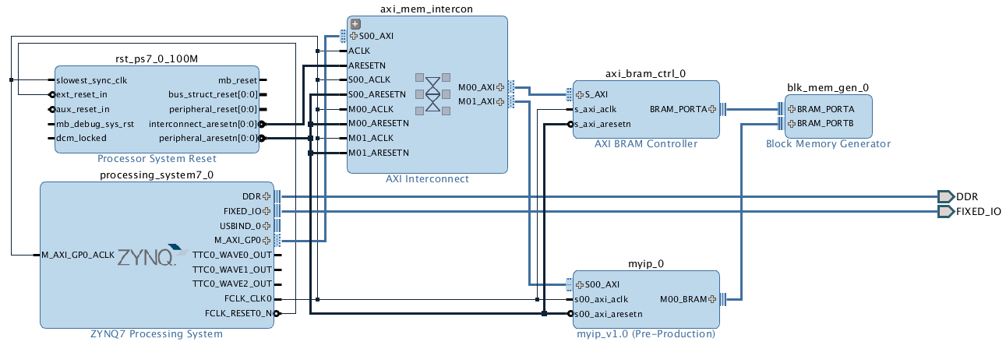
Interconnects
[UG585 Zynq TRM, 2016]
Interconnect switches
Central Interconnect
Master Interconnect
Slave Interconnect
Memory Interconnect
OCM Interconnect
Notes:
The interconnect that is located within the PS facilitates the communication of read, write and response transactions between master and slave clients, and is comprised of multiple switches to connect system resources using AXI point-to-point channels. The interconnect, belonging to the ARM AMBA family of buses, implements a large array of interconnect communication capabilities and overlays for Quality-of-Service (QoS), debug and test monitoring. Multiple outstanding transactions are managed by the interconnect, which is designed for low-latency paths for ARM CPUs.
Interconnect Switches
Central Interconnect — The central interconnect is the core of the ARM NIC-301-based interconnect switches.
Master Interconnect — The master interconnect controls the switching of the low-to-medium speed traffic from AXI_GP ports, Device Configuration (DevC) and Device Access Port (DAP) to the central interconnect
Slave Interconnect — The slave interconnect controls the switching of low-to-medium speed traffic from the central interconnect to I/O peripherals, AXI_GP and other blocks
Memory Interconnect — The memory interconnect controls the switching of high-speed traffic from the AXI_HP ports to DDR DRAM and OCM (via the OCM interconnect).
OCM Interconnect — The OCM interconnect controls the switching of high-speed traffic between the OCM and the central and memory interconnects.
SCU— The SCU functions like a switch from the perspective of traffic to its AXI master ports and from its AXI slave ports, due to the address filtering feature.
L2 Cache Controller — The L2 cache controller functions like a switch from the perspective of traffic to its AXI master ports and from its AXI slave ports, due to the address filtering feature.

Slide 46
Week 9: SW Communicates with BRAM
for (i = 0; i < SIZE; i++)
printf("%-10d%-10X\n", i, *(fpga_bram + i));

Slide 47
Interconnects
[UG585 Zynq TRM, 2016]
Interconnect switches
Central Interconnect
Master Interconnect
Slave Interconnect
Memory Interconnect
OCM Interconnect

Slide 48
Week 10: Hardware Communication on Bus Interconnect
Communication between hardware components
CPU – bus (interconnect) – BRAM controller
BRAM controller – my hardware component
Xilinx Zynq (XC7Z020)
Processing System
(PS, ARM Co-A9)
Programmable Logic
(PL, Xilinx Artix-7)
Core #1
Matrix-Vector Multiplication Custom IP
Core #2
Memory interface
AXI master
BRAM

Slide 49
Week 10: BRAM + My Hardware Component
Notes:
PS –> M_AXI_GP -> AXI_INTERCONNECT -> BRAM
PS –> M_AXI_GP -> AXI_INTERCONNECT -> MYIP
MYIP -> BRAM

Slide 50
Interconnects
[UG585 Zynq TRM, 2016]
Interconnect switches
Central Interconnect
Master Interconnect
Slave Interconnect
Memory Interconnect
OCM Interconnect

Slide 51
Next Week (Week 10)
Communication between hardware components
CPU – bus (interconnect) – BRAM controller
BRAM controller – my hardware component
Bus interconnect
ARM AMBA3 AXI protocol
Split transaction
Multiple read/write channels per port
Crossbar interconnect
Out of order transaction
Deadlock problem and solution
Xilinx Zynq (XC7Z020)
Processing System
(PS, ARM Co-A9)
Programmable Logic
(PL, Xilinx Artix-7)
Core #1
Matrix-Vector Multiplication Custom IP
Core #2
Memory interface
AXI master
BRAM

Slide 52
Agenda
Lecture
How can software access hardware accelerator?
How can hardware accelerator access main memory?
Introduction to the lab on Week 9

